Slide 1
Brief Introduction of SocketPro Async Communication Framework
Continuous Request Sending, Processing and Returning for the Best Network Efficiency and Throughput
Yuancai (Charlie) Ye

Slide 2
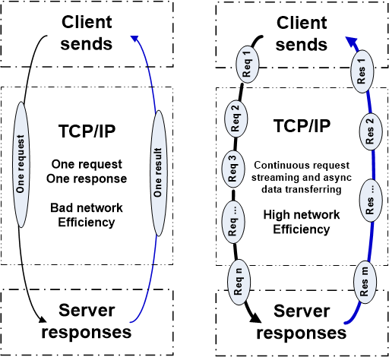
Two Basic Communication Patterns

Slide 3
Advantages and Disadvantages
SCF (Synchronous Communication Frameworks) | ACF (Asynchronous Communication Frameworks)
Good for typical applications Easy to get started Many free SCFs available Good for Local Area Networks (LAN) Simple in coding logic and better code readability Easy in debugging | Great for high-quality applications Great for challenging tasks Multiple communication models integrated Great for both LAN and WAN Great performance, UI response and scalability because of streaming & batching Great for both fat and thin clients Less threading-related issues Better user-code consistence
Bad for high-quality applications Bad for challenging tasks One communication model only Bad for Wide Area Networks (WAN) Bad performance, latency and UI response No dev/design freedom Many threading-related issues Bad scalability | Fewer high quality ACFs available Slightly more complex in coding logic and readability Slightly more difficult in debugging Difficult to create an ACF

Slide 4
SocketPro Communication Architecture and Components
Client Core
cross-platform
native code
Server Core
cross-platform
native code
Request batching and streaming, asynchrony, secure, parallel communication on TCP/IP
C++
Adapter
.Net
Adapter
Java
Adapter
Python
Adapter
JavaScript
Adapter
PHP
Adapter
Node.js
Adapter
C++
Adapter
.Net
Adapter
Python
Adapter
Java
Adapter
User Client Code
User Server Code

Slide 5
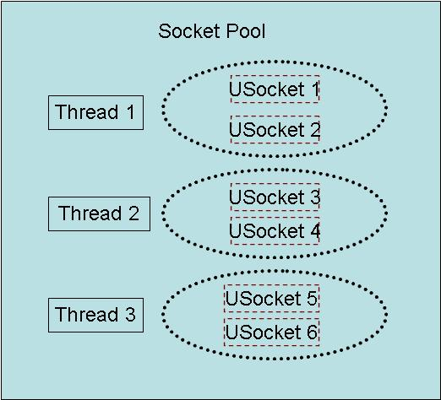
Client Socket Pool
A socket pool has three worker threads and each of these threads hosts two non-blocking sockets with fault tolerance for the best parallelism

Slide 6
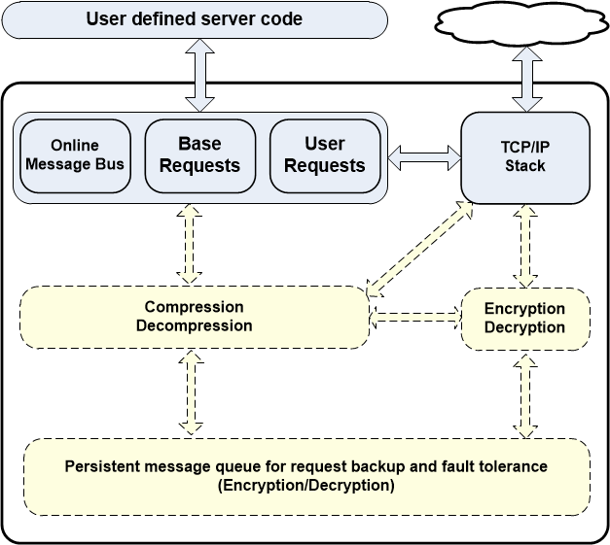
Client Core Features

Slide 7
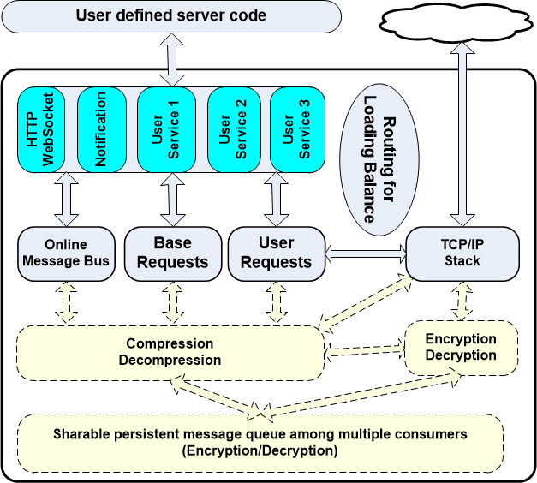
Server Core Features

Slide 8
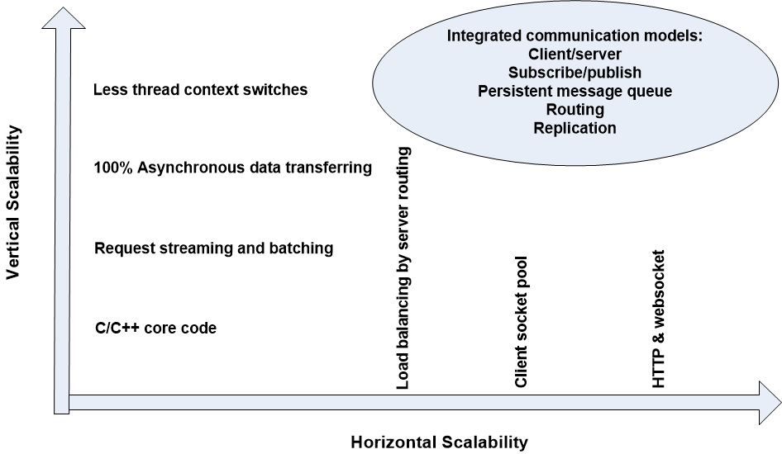
SocketPro Scalabilities

Slide 9
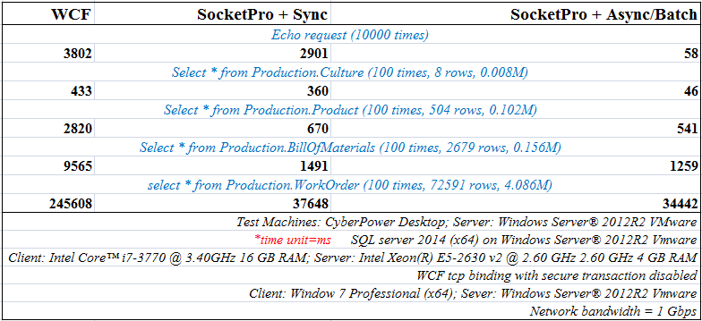
Client/Server Pattern

Slide 10
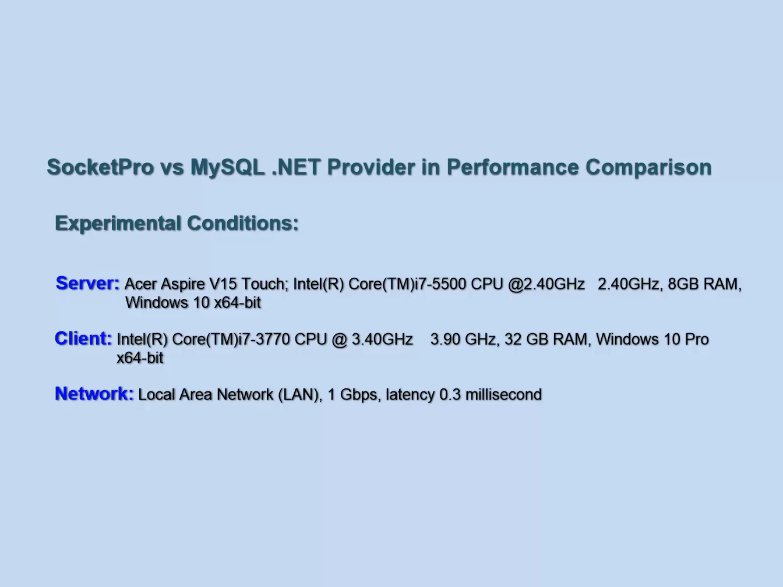
SocketPro vs MySQL .NET Provider (LAN)

Slide 11
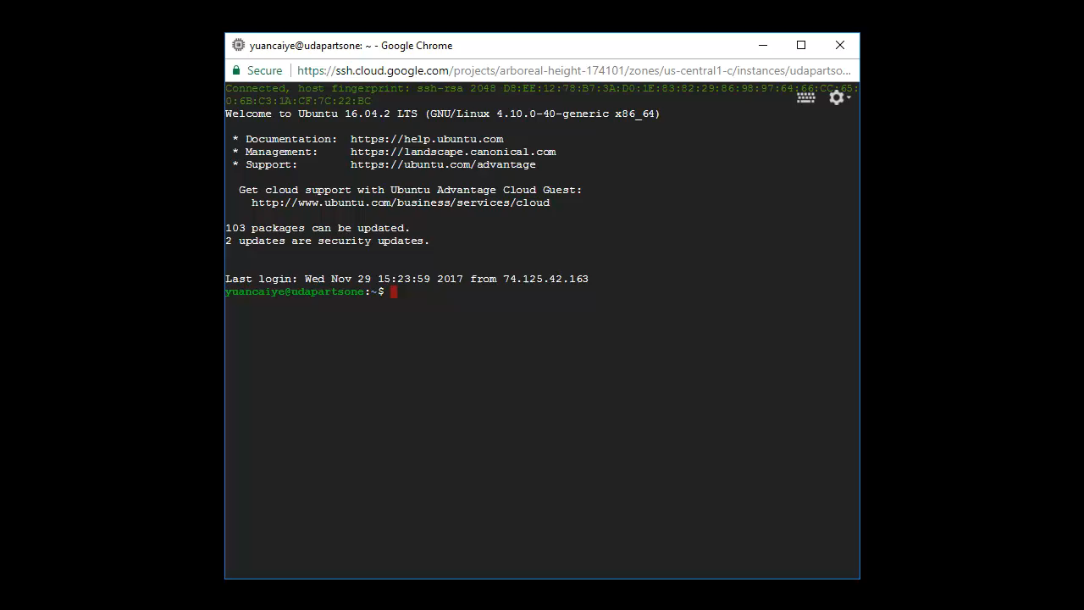
SocketPro vs MySQL .NET Provider (WAN)

Slide 12
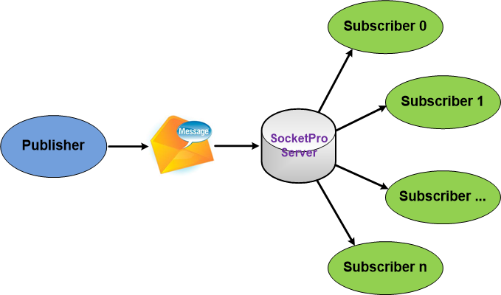
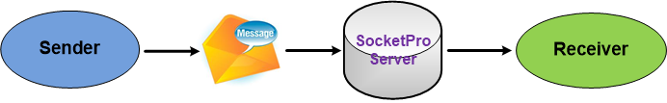
SocketPro Subscribe/Publish (Internet chat or online messaging)

Slide 13
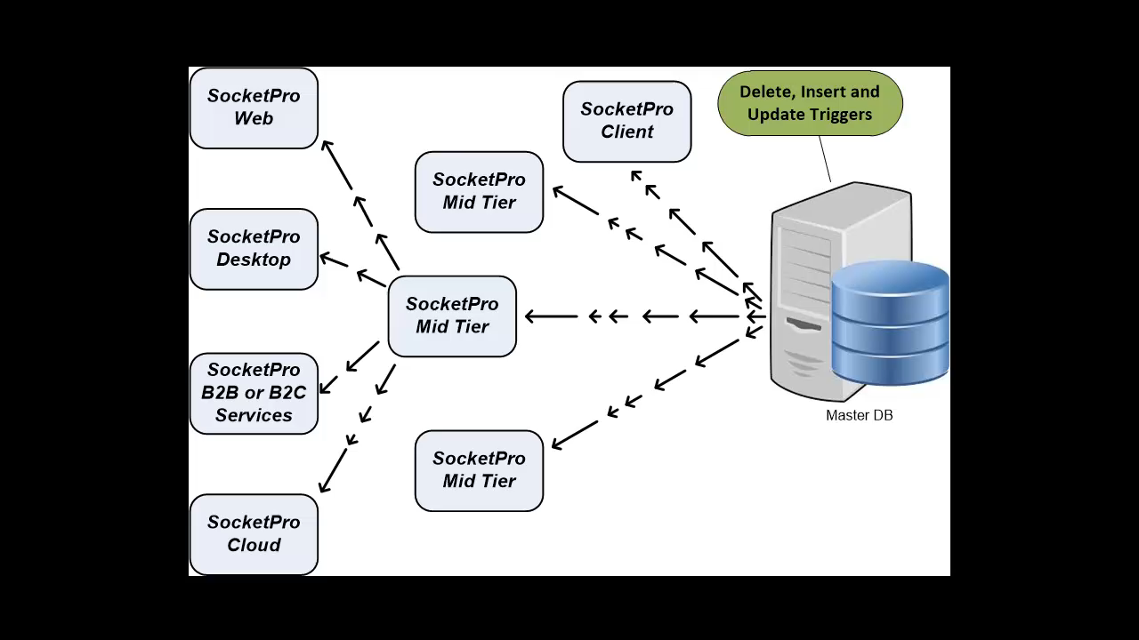
DB Events and Real-time Update Cache

Slide 14
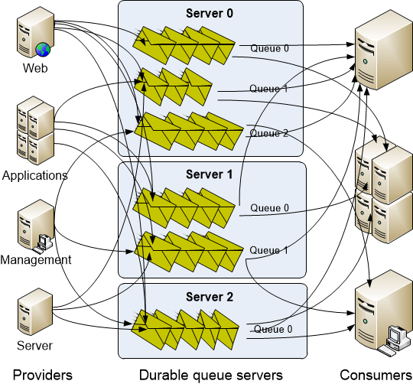
SocketPro Persistent Message Queue
Advantages of SocketPro over Kafka:
Manual transaction
Queue sharable among multiple consumers
Real-time message availability event (low latency)
No configuration settings
Faster than Kafka in message writing
Select a portion of requests to be queued persistently
No message loss as messages can be backed up at provider side

Slide 15
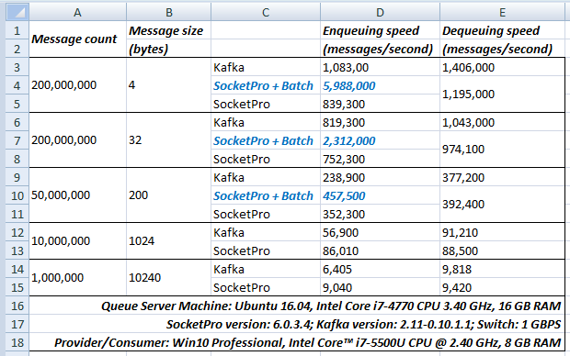
Performance Comparison between SocketPro Persistent Queue and Kafka

Slide 16
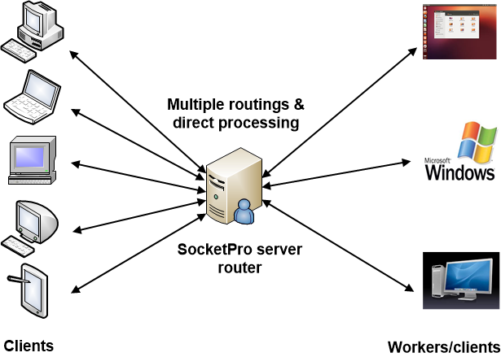
SocketPro Server Requests Routing for Loading Balance with Fault Tolerance

Slide 17
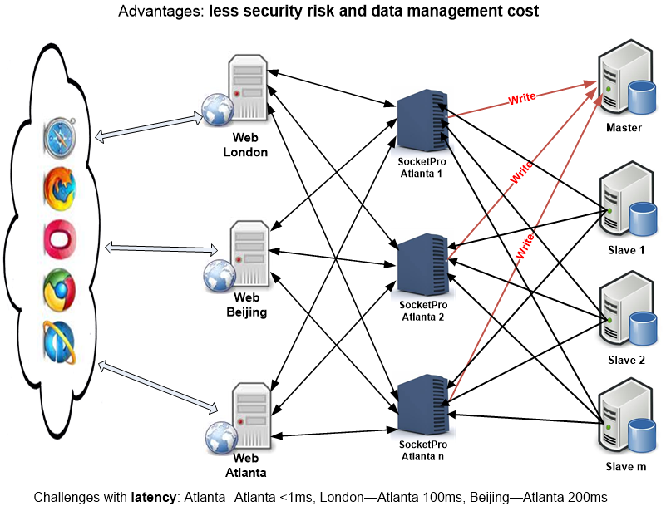
Enterprise Master/Slave Distributed Systems by SocketPro

Slide 18
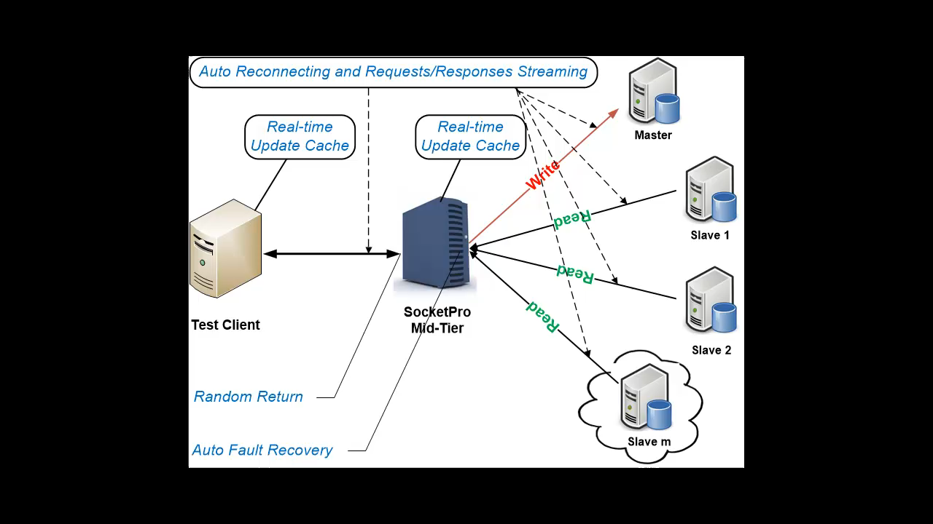
Master/Slave Pools for Enterprise Applications (Real-time Cache and SQL/Request Streaming)

Slide 19
SocketPro Plugins
Persistent Message Queue
Cross-platform File Streaming
Database Plugins
SQLite with Real-time Update Cache
MySQL with Real-time Update Cache
MS SQL with Real-time Update cache
ODBC
Others (PostgreSQL, MariaDB, DB2, Oracle – TBD)
Other Applications (Future)

Slide 20
Road Maps
Add more SQL streaming plugins for PostgreSQL, MariaDB, DB2, Oracle and others
Add more adapters (PHP, Node.js and others)
Automatic faults recovery and coding simplification on adapter level
Port SocketPro core components to Android, IPhone and Apple.
Better documentations and demo examples

Slide 21
Major Web Sites
https://github.com/udaparts/socketpro
http://www.udaparts.com/
https://www.codeproject.com/Articles/1204807/Brief-introduction-of-a-continuous-SQL-stream-send
https://www.codeproject.com/Articles/1207129/Brief-introduction-of-a-continuous-SQL-stream-se

Slide 22
Questions ?

